Slide 1
Sharpening Your Tools: Talking to Patients About HIV Prevention
This activity is supported by an educational grant from Gilead Sciences, Inc.

Slide 2

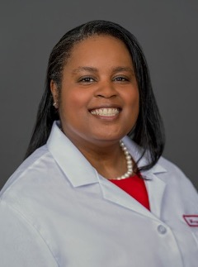

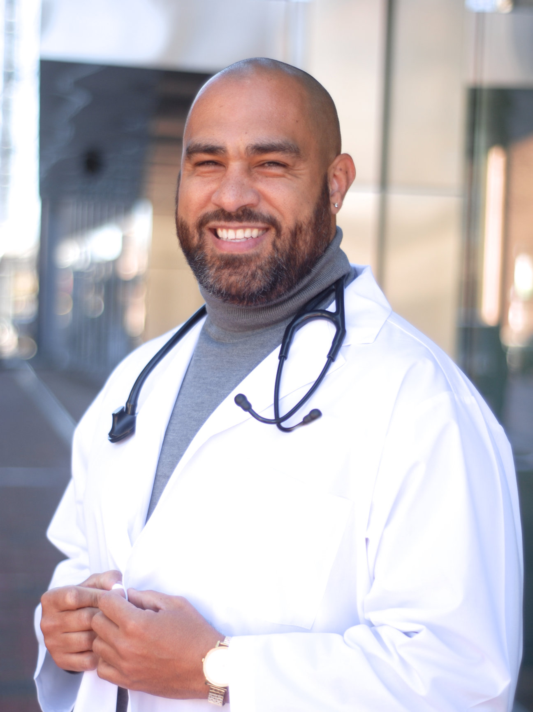
David Alain Wohl, MD
Infectious Disease Specialist
Chapel Hill, North Carolina
Margot Savoy, MD, MPH
Family Physician
Philadelphia, PA
Quintin Robinson, MD
Infectious Disease Specialist
Atlanta, GA
David J. Malebranche, MD, MPH
Internal Medicine/Sexual Health/HIV Specialist
Atlanta, GA

Slide 3
Taking the Awkward Out of Taking a Sexual History
David Wohl, MD
Margot Savoy, MD

Slide 4
Before You Begin: Ensuring a Productive Conversation
✓
Avoid moral or religious judgment of the patient’s behavior
Avoid terms that make assumptions about sexual behavior or orientation (e.g., “How many partners have you had in the past year?” rather than “Are you monogamous?”
✓
Ensure understanding around terminology and pronunciation for patients concerns to avoid confusion (e.g., if a patient uses slang for their anatomy, gently connect the slang word to medical terminology by answering with corresponding anatomy)
✓
1. Savoy M, et al. Am Fam Physician. 2020;101(5):286-293. 2. Nusbaum MR, et al. Am Fam Physician. 2002;66(9):1705-1712.

Slide 5
Before You Begin: Ensuring a Productive Conversation
✓
Establish rapport and consent before addressing sensitive topics
✓
Respect the patient’s right to decline answering questions or sharing information
✓
Use a sensitive tone that normalizes the topics you are discussing
Use neutral and inclusive terms that avoid assumptions about orientation (e.g., partner)
✓
1. Savoy M, et al. Am Fam Physician. 2020;101(5):286-293. 2. Nusbaum MR, et al. Am Fam Physician. 2002;66(9):1705-1712.

Slide 6
Five P’s Model of Sexual Health
Guide assessment of risk, testing and prevention strategies
Identification of anatomical site for specimen collection
A prior history of STDs may place the patient at greater risk now
Protection from STD/STI
Past history of STD/STI
Pregnancy plans
Partners
Practices
To assess risk of STD
Length of relationship, risk factors of partner, partner drug use, condom use
Determine risk of becoming pregnant or fathering a child
Questions should be gender appropriate
Need to determine appropriate level of risk-reduction counseling
STDs = sexually transmitter diseases; STI = sexually transmitted infection
CDC. https://www.cdc.gov/std/treatment/SexualHistory.pdf. Accessed October 2 , 2021.

Slide 7
General Questions to Begin the Sexual History
Are you currently sexually active? Have you ever been?
What is your gender? How do you identify? What pronouns do you prefer?
1. Savoy M, et al. Am Fam Physician. 2020;101(5):286-293. 2. Nusbaum MR, et al. Am Fam Physician. 2002;66(9):1705-1712.

Slide 8
Five P’s Model of Sexual Health
How do your partners identify? Do they identify as male, female, or another?
How many partners have you had in the last month? The past 6 months? Your lifetime?
How satisfied are you with your sexual functioning?
Has there been any change in your (or your partner’s sexual desire or frequency of sexual activity?
Partners
I am going to be more explicit here about the kind of sex you have had to better understand your risk for STDs
What type of sexual activities do you participate in?
Do you participate in vaginal sex ? Oral sex? Anal sex?
Practices
1. Savoy M, et al. Am Fam Physician. 2020;101(5):286-293. 2. Nusbaum MR, et al. Am Fam Physicians. 2002;66(9):1705-1712.
3. https://www.cdc.gov/std/treatment/SexualHistory.pdf. Accessed May 28, 2021.

Slide 9
Five P’s Model of Sexual Health
Protection from STD/STI
Do you and your partner(s) use any protection against STDs? If so, what kind of protection do you use?
How often do you use this protection?
Have you ever had any sex-related disease?
Do you have, or have you ever had, any risk factors for HIV?
Have you ever been tested for HIV? Would you like to be?
What do you do to protect yourself from contracting HIV?
Past history of STD/STI
Pregnancy plans
Are you concerned about getting pregnant or getting your partner pregnant?
Are you using contraception or practicing birth control?
1. Savoy M, et al. Am Fam Physician. 2020;101(5):286-293. 2. Nusbaum MR, et al. Am Fam Physician. 2002;66(9):1705-1712.
3. CDC. https://www.cdc.gov/std/treatment/SexualHistory.pdf. Accessed May 28, 2021.

Slide 10
Things to Consider When Prescribing PrEP
David Wohl, MD
Margot Savoy, MD

Slide 11
Who Should be Prescribed PrEP?
Sexually-Active Adults and Adolescents | Persons Who Inject Drugs
Anal or vaginal sex in the past 6 months; and HIV-positive sexual partner (especially if partner has known or detectable viral load); or Recent bacterial STI; or History on inconsistent or no condom use | HIV+ injecting partner Sharing injection equipment
Documented negative HIV test result before prescribing PrEP; and No signs/symptoms of acute HIV infection; and Normal renal function; and No contraindicated medications
CDC. https://www.cdc.gov/hiv/pdf/risk/prep/cdc-hiv-prep-guidelines-2017.pdf. Accessed October 2, 2021.

Slide 12
FDA-Approved Formulations of PrEP
Tenofovir disoproxil fumarate/emtricitabine: F/TDF
Tenofovir alafenamide/emtricitabine: F/TAF
What factors should be considered when deciding which formulation to choose for adolescents/young adults who are at risk for HIV infection?

Slide 13
Consideration #1: Assessment of the Type of Sexual Activity
If the PrEP candidate is at-risk for HIV infection through receptive vaginal sex, then as the only PrEP medication approved for this population, F/TDF should be chosen
Truvada®. Foster City, CA: Gilead Sciences, Inc; 2013. https://www.accessdata.fda.gov/drugsatfda_docs/label/2013/021752s035lbl.pdf. 2013. Accessed October 2, 2021.

Slide 14
Consideration #2: Renal Health
Risk Factors
Renal health should be evaluated before or when prescribing PrEP to avoid administration to individuals with renal impairment or declining renal function
F/TDF should not be prescribed to anyone with eCrCl of 60 ml/min
Serum creatinine should be measured at 3 months and every 6 months thereafter
Diabetes
Hypertension
CKD or declining renal function
Use of stimulants
Other medication with renal AEs
Family history of CVD
AEs = adverse events; CKD = chronic kidney disease; CVD = cardiovascular disease;
eCrCl = estimated creatinine clearance
1. Fields SD, et al. Infect Dis Ther. 2021;10(1):165-186.
2. CDC. https://www.cdc.gov/hiv/pdf/risk/prep/cdc-hiv-prep-guidelines-2017.pdf. Accessed October 2, 2021

Slide 15
Consideration #2: Renal Health
A real-world study of 4,514 participants dispensed PrEP (F/TDF) was presented to quantify the rates of renal impairment
  2-year cumulative risk of renal impairment of 1.7% was observed
  Significantly higher risk was associated with older patients and pre-existing renal dysfunction¹
In the DISCOVER trial (n = 5,387) of F/TDF compared to F/TAF statistically significant differences in renal safety were observed with F/TAF at 96 weeks
  F/TAF had increases in estimated glomerular filtration rate (eGFR), and declines in UPCR and PTI biomarkers compared to F/TDF at 96 weeks
  Key differences favoring F/TAF were also observed in markers of proximal tubular function²
F/TAF demonstrated noninferior efficacy compared to F/TDF
PTI = Proximal tubular injury; UPCR = urine protein to creatinine ratio
1. McManus H, et al.. In special issue from the 2020 Conference on Retroviruses and Opportunistic Infections; 2020. Abstract No. 1004. Top Antivir Med. 2020;28(1):483.
2. Ogbuagu O, et al. Lancet HIV. 2021;8(7):e397-e407.

Slide 16
Consideration #3: Bone Health
Studies have demonstrated declines in bone mineral density (BMD) F/TDF PrEP¹
Adolescents and young adults age ≤ 25 are still developing bone mass, creating a concern about the impact of F/TDF on BMD²
Bone-related conditions like osteopenia or osteoporosis
Lifestyle factors that have a negative impact on bone health
Smoking
Sedentary lifestyle
Poor diet
Alcohol use disorder
Methamphetamine use
Risk Factors
Eating disorders
Vitamin D deficiency
Low BMI
1. Fields SD, et al. Infect Dis Ther. 2021;10(1):165-186.
2. Ogbuagu O, et al. Lancet HIV. 2021;8(7):e397-e407.

Slide 17
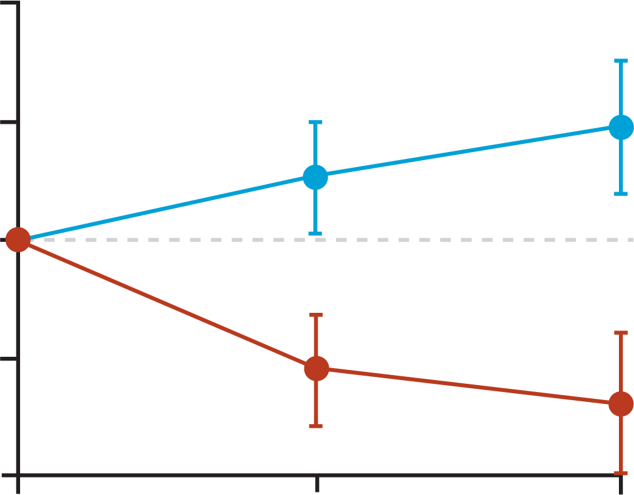
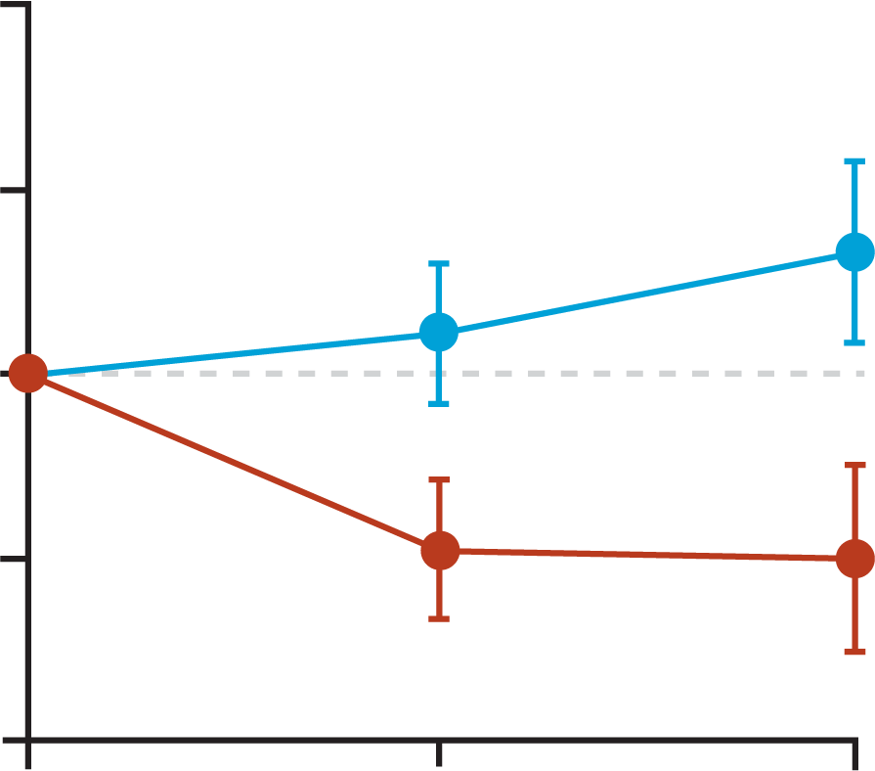
Long-Term Data Show Greater Bone Safety with F/TAF vs F/TDF at 96 Weeks
Spine BMD
Hip BMD
2.0
2.0
p < .0001*
p < .0001
p < .0001*
1.0
1.0
1.0
p < .0001
0.6
0.5
0.2
Mean Percentage Change from Baseline
Mean Percentage Change from Baseline
0
0
-1.0
-1.0
-1.0
-1.1
-1.0
-1.4
-2.0
-2.0
0
48
96
0
48
96
n
Week
Week
F/TAF
F/TDF
159
160
144
140
F/TAF
F/TDF
158
158
140
137
p values were from an ANOVA model with baseline F/TDF for PrEP and treatment as fixed effects
Ogbuagu O, et al. Lancet HIV. 2021;8(7):e397-e407.

Slide 18
PrEP Follow-up
At 3 months after PrEP initiation | Test for HIV Measure serum creatinine and estimate creatinine clearance Provide medication adherence and behavioral risk reduction support Additional for: MSM: screen for bacterial STIs* Women with reproductive potential: test for pregnancy and PWID: assess access to clean needles/syringes and drug treatment services
Every 3 months after the first 3-month follow-up | Test for HIV Provide medication adherence and behavioral risk reduction support Additional for: MSM: screen for bacterial STIs* Women with reproductive potential: test for pregnancy and PWID: assess access to clean needles/syringes and drug treatment services
Every 6 months after the first 3-month follow-up | Measure serum creatinine and estimate creatinine clearance For all sexually active patients: Screen for bacterial STIs*
MSM = men who have sex with men; PWID = people who inject drugs
*Nucleic Acid Amplification Test (NAAT) to screen for gonorrhea and chlamydia based on anatomic site of exposure; blood test for syphilis
CDC. https://www.cdc.gov/hiv/clinicians/prevention/prep.htm. Accessed October 2, 2021.

Slide 19
Consideration #4: Adherence
$\sim$ 99% efficacy of PrEP with high rates of adherence
In general, young people report lower levels of adherence to any medication
Barriers to adherence
  Substance use
  PrEP side effects
  Poor health status
  Perceived low risk of HIV infection
  Inconvenience
  Social stigma
  Social determinants of health
1. CDC. https://www.cdc.gov/hiv/pdf/risk/prep/cdc-hiv-prep-guidelines-2017.pdf. Accessed October 2, 2021.
2. Ching SZ, et al. AIDS Educ Prev. 2020;32(5):416-431.

Slide 20
Factors Facilitating Adherence to PrEP
Individual
Provider Support
Societal Support
External reminders (alarms, automated phone reminders)
Use of pillbox
Tied to daily activities (brushing teeth)
Perceived risk of HIV infection
Perceived benefits of PrEP
Rapport with PrEP HCP—communication, trust, consistent quality of care
Counseling sessions tailored to individual needs
Ongoing counseling during follow-up visits
Family and peer support
  Reminders
  Monitoring
Payer assistance
Ching SZ, et al. AIDS Educ Prev. 2020;32(5):416-431.

Slide 21
Creating an Inclusive Clinical Practice
David Malebranche, MD
Quintin Robinson, MD
Notes:
At Marker 5
Do an intro for creating an inclusive practice

Slide 22

Structural Barriers to PrEP Adoption
Growth of PrEP is slower among racial and ethnic minority communities
Attributed to experiences of homophobia and racism in health care, as well as broader racism and socioeconomic inequality
Physical barriers encountered navigating healthcare system
Social determinants of health foster mistrust between providers and patients impacting communication and shared decision-making
Jaiswal J, et al. AIDS Behav. 2021 Apr 8. doi.1007/s10461-021-03254-4. Online ahead of print.

Slide 23

Deterrents to PrEP Prescribing: Undercurrents of Social Biases
Manifestations of sexual orientation-bias may impact PrEP access
Heterosexist attitudes and stereotypes may heighten providers’ concerns about patient behaviors
  Promiscuity and irresponsibility are sexual stereotypes ascribed to MSM
  PrEP-related risk compensation, risk-taking, number of sexual partners may be judged more harshly in MSM than for heterosexuals
  Concerns about adherence to treatment
Racial biases that Black MSM are more likely to engage in condomless sex than White MSM when on PrEP
MSM = men who have sex with men
1. Calabrese SK, et al. AIDS Behav. 2018;22(4):1122-1138. 2. Calabrese SK, et al. AIDS Behav. 2014;18(2):226-240.

Slide 24

Social Determinants of PrEP Inequities
Logistical barriers to access
  Transportation
  Time constraints
38% in the Black community more than an hour drive from a PrEP provider
  People in areas of high PrEP density more likely to use PrEP
Limited access to quality medical and LGBTQ-sensitive care
1. Mayer KH, Agwu A, Malebranche D. Adv Ther. 2020;37(5):1778-1811. 2. Ojikutu BO, et al. JMIR Public Health Surveill. 2019;5(1):e12405.

Slide 25
Creating Change: Education of Patients and Providers is Key
✓
Community-based education to raise awareness and combat implicit and unconscious bias and instill trust in the healthcare system
✓
More Black health care providers as trusted community sources of knowledge
✓
Address unfounded beliefs about risk compensation that feeds reluctance to PrEP
✓
Positive messaging to patients via social networks and social media to improve knowledge, attitudes, and reduce stigma
✓
Support prevention messages for HIV and STIs through monitoring and testing
Mayer KH, Agwu A, Malebranche D. Adv Ther. 2020;37:1778-1811.

Slide 26
Creating a Safe and Welcoming Environment for Discussion About Sexual Health
Use a proactive, patient-centered approach that includes, but is not limited to disease identification and treatment
Train staff in culturally sensitive terminology, using gender-inclusive language on forms, implicit bias, and displaying diverse images in waiting areas
  Small process changes like using a 2-step method (asking 2 questions about both gender identity and gender at birth) or using self-identified pronouns
Build a culture that reassures the patient or adolescent the practice is a confidential, safe, affirming, non-judgmental space
1. Savoy M, et al. Am Fam Physician. 2020;101(5):286-293. 2. Ryan KL, et al. PRiMER. 2018;2:23.
3. Pfeffer B, et al. Pediatr Clin North Am. 2017;64(2):291-304.

Slide 27
Health Care Team Collaborations to Expand Opportunities for PrEP Prescribing
HIV screening and PrEP prescribing in emergency department
NPs/PAs in over 3,000 retail health clinics nationally
Pharmacist PrEP initiatives
  One-Step PrEP® program which allows PrEP access following a single patient encounter
  In CA, pharmacists can provide PrEP medications without a prescription
Opportunity to establish partnerships between medical, public health, and social services
CA = California; NPs = nurse practitioners
1. Mayer KH, Agwu A, Malebranche D. Adv Ther. 2020;37:1778-1811. 2. Tung EL, et al. Sex Health. 2018;15:556-561.
3. Koester KA, et al. J Am Pham Assoc (2003). 2020;60(6):e179-e183.

Slide 28
SMART Goals
Specific, Measurable, Attainable, Relevant, Timely
Create a safe and welcoming environment that is conducive to open and candid conversations about sexual history and sexual health
Use neutral and inclusive terms that avoid assumptions about sexual orientation (e.g., partner)
Offer PrEP to adolescents who are HIV-negative and are at-risk for contracting HIV
Address structural and system barriers to PrEP
Combat social biases that hinder use of PrEP
Factor risk factors for long-term negative impact on bone and renal health into PrEP treatment decisions
Counsel patients about adherence on each follow-up visit and share strategies they can implement into their daily lives to promote adherence

